Slide 1

COLLEGE ACCESS BILL Higher Education Housing and Opportunities Act
November 12, 2025
Alyssa Phillips
Aphillips@chicagohomeless.org

Slide 2


About
Since 1980, Chicago Coalition to end Homelessness (CCH) has advocated for a world where everyone has a safe, welcoming, and permanent place to call home.
Our Mission is building community power and advances racial equity through organizing, advocacy, legal assistance, and education to prevent and end homelessness because housing is a human right.

Slide 3

HOW We got here
Despite facing many challenges including deep poverty and instability many youth who experience homelessness wish to pursue careers that require some form of postsecondary education.

Slide 4

HOW we got here
Students experiencing homelessness are often invisible on college campuses, unsure if there are services available, and confused about who they should turn to when problems arise.
Students attempt to blend in because they want to be like other students despite their atypical circumstances.

Slide 5

How we got here
Students experiencing homelessness who were part of our scholarship program shared their perspectives and expressed struggles with applying for financial aid, finding housing, and identifying staff on campus who can answer their questions.

Slide 6

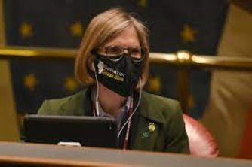
Higher Education Housing and Opportunities Act
This conversation inspired what became SB190 (Public Act 102-0083) – Higher Education Housing and Opportunities Act (Sen. Glowiak-Hilton and Rep. West).

Slide 7

Definition
A student experiencing homelessness or homeless student is “an individual enrolled in an institution who lacks or is at imminent risk of lacking a fixed, regular, and adequate nighttime residence or whose parent or legal guardian is unable or unwilling to provide shelter and care and includes a homeless individual as defined under the federal McKinney-Vento Homeless Assistance Act."

Slide 8
Indicators a student might be an unaccompanied homeless youth:​
Overly concerned about how to complete documentation needed for the institution that requires parental signatures​
Difficulty providing an address​
Giving vague answers about their living situation​
Stressed about where they will be living during the summer​
Hunger​
Wearing the same clothes repeatedly ​
Exhaustion ​
Expressing feeling like their only option is to drop out of school

Slide 9

To aid students experiencing homelessness, each institution of higher education shall designate at least one staff member to serve as a liaison to assist homeless students enrolled at the institution.

Slide 10


HOUSE LIAISON
​
The designated staff member may be employed in the office of financial aid, in campus housing services, or in any other appropriate office or department as determined by the institution.

Slide 11

HOUSE LIAISON
​Under 110 ILCS 131/10 (a) the liaison designated shall offer assistance and resources to any homeless student or student enrolled at the institution.
The liaison shall have the following responsibilities:

Slide 12

HOUSE LIAISON
To understand provisions pertaining to the financial aid eligibility of homeless students, including eligibility as an independent student under the federal Higher Education Act of 1965.

Slide 13

HOUSE LIAISON
To identify services and resources that are available to and appropriate for a homeless student

Slide 14

HOUSE LIAISON
To assist homeless students or students in care in applying for and receiving federal and State financial aid and available services.

Slide 15

HOUSE LIAISON
To track and monitor the graduation rate and retention rate of homeless students and students in care enrolled at the institution.

Slide 16

HOUSE LIAISON
To publish on the institution's website information about the services and resources available through the institution's liaison, as well as contact information for local, State, and federal services.

Slide 17


HOUSE LIAISON
To develop a plan to provide access to on-campus housing or to suitable off-campus housing between academic breaks to homeless students or students in care enrolled at the institution.

Slide 18
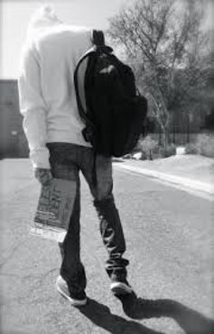
HOUSE LIAISON
To act as an intermediary between a homeless student or student in care and the office of financial aid, student support services, and campus housing services.
To connect a homeless student or student in care to a local continuum of care program.

Slide 19

HOUSE LIAISON
To train the institution's employees to identify students experiencing homelessness and to refer those students to the liaison.

Slide 20


Each institution that provides on-campus housing for students enrolled at the institution shall:

Slide 21
Housing
Grant priority for on-campus housing to students experiencing homelessness and students in care who are enrolled at the institution, including but not limited to, access to on-campus housing that remains open during academic breaks, and waive fees for the on-campus housing during academic breaks

Slide 22
Housing
Allow students experiencing homelessness and students in care who are enrolled part-time at the institution to access on-campus housing.

Slide 23

Housing
Provide information about the availability of on-campus housing to students experiencing homelessness and students in care.

Slide 24
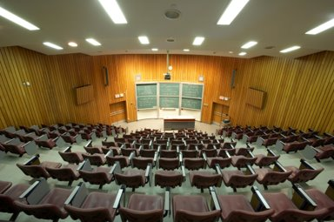
Housing
Provide information about the services and assistance offered by the institution regarding homelessness in financial aid and admission packets and on the institution's website.

Slide 25

Housing
Collaborate with the State Coordinator for McKinney-Vento Homeless Education and the contact liaisons to facilitate the efficient transition of homeless students from secondary to postsecondary education

Slide 26

Housing
Provide homeless students and students in care information about support services, including financial aid, on-campus and off-campus housing, food and meal plan programs, and counseling services, and other resources and any other relevant information to assist these students.

Slide 27

Best practice is for information to be shared with all students about resources for students experiencing homelessness.
Best Practice

Slide 28

It is critical that students experiencing homelessness are aware of resources on campus. Use various methods such as, emails, flyers, posters, school websites and social media accounts, and appropriate and safe in-person visits to provide information to students experiencing homelessness.
Best Practice

Slide 29

Create a list of resources available through the school and community that can be shared with students.
Best Practices

Slide 30

Establish a contact person with departments at the school and local community organizations that provide services to students experiencing homelessness such as food pantries, youth drop-in centers, housing and case management.
Best Practices

Slide 31

BEST PRACTICES
Record or host webinars that discuss resources and assistance with financial aid for students experiencing homelessness and facility and staff that are interested in learning how to support their students.

Slide 32
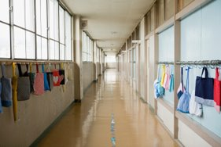
BEST PRACTICES
Schools should consistently collect and update contact information of students experiencing homelessness.​
This includes current address, phone numbers (including cell and alternate phone numbers), email address, and emergency contact information.​
Schools should reach out to students to update this information monthly.

Slide 33
CONTACT INFORMATION
Alyssa Phillips
aphillips@chicagohomeless.org
872.588.6800

